Slide 1
Ada Lovelace: The Visionary Pioneer of Programming
Unveiling the Legacy of the First Computer Programmer

Slide 2
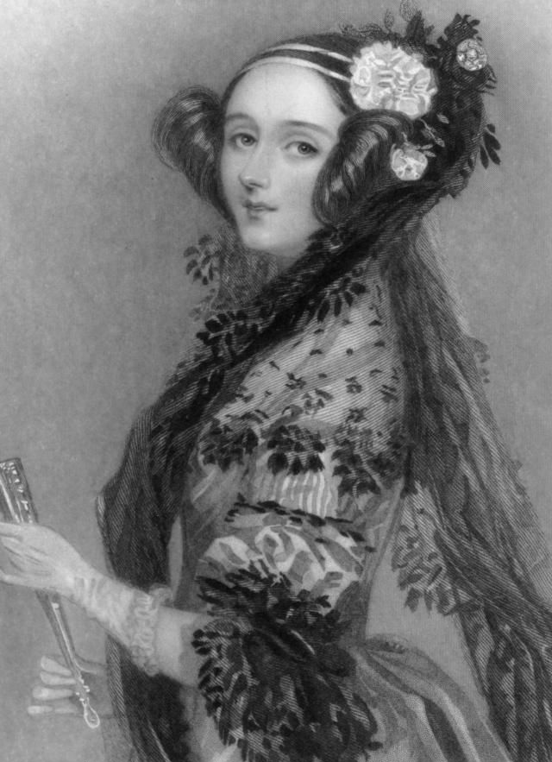
Who Was Augusta Ada King, Countess of Lovelace?
Born December 10, 1815, in London, England.
Daughter of the famous poet Lord Byron and the mathematician Anne Isabella Milbanke.
Received a rigorous education in mathematics and science.
Her analytical mind set her on a path to revolutionize computing.

Slide 3
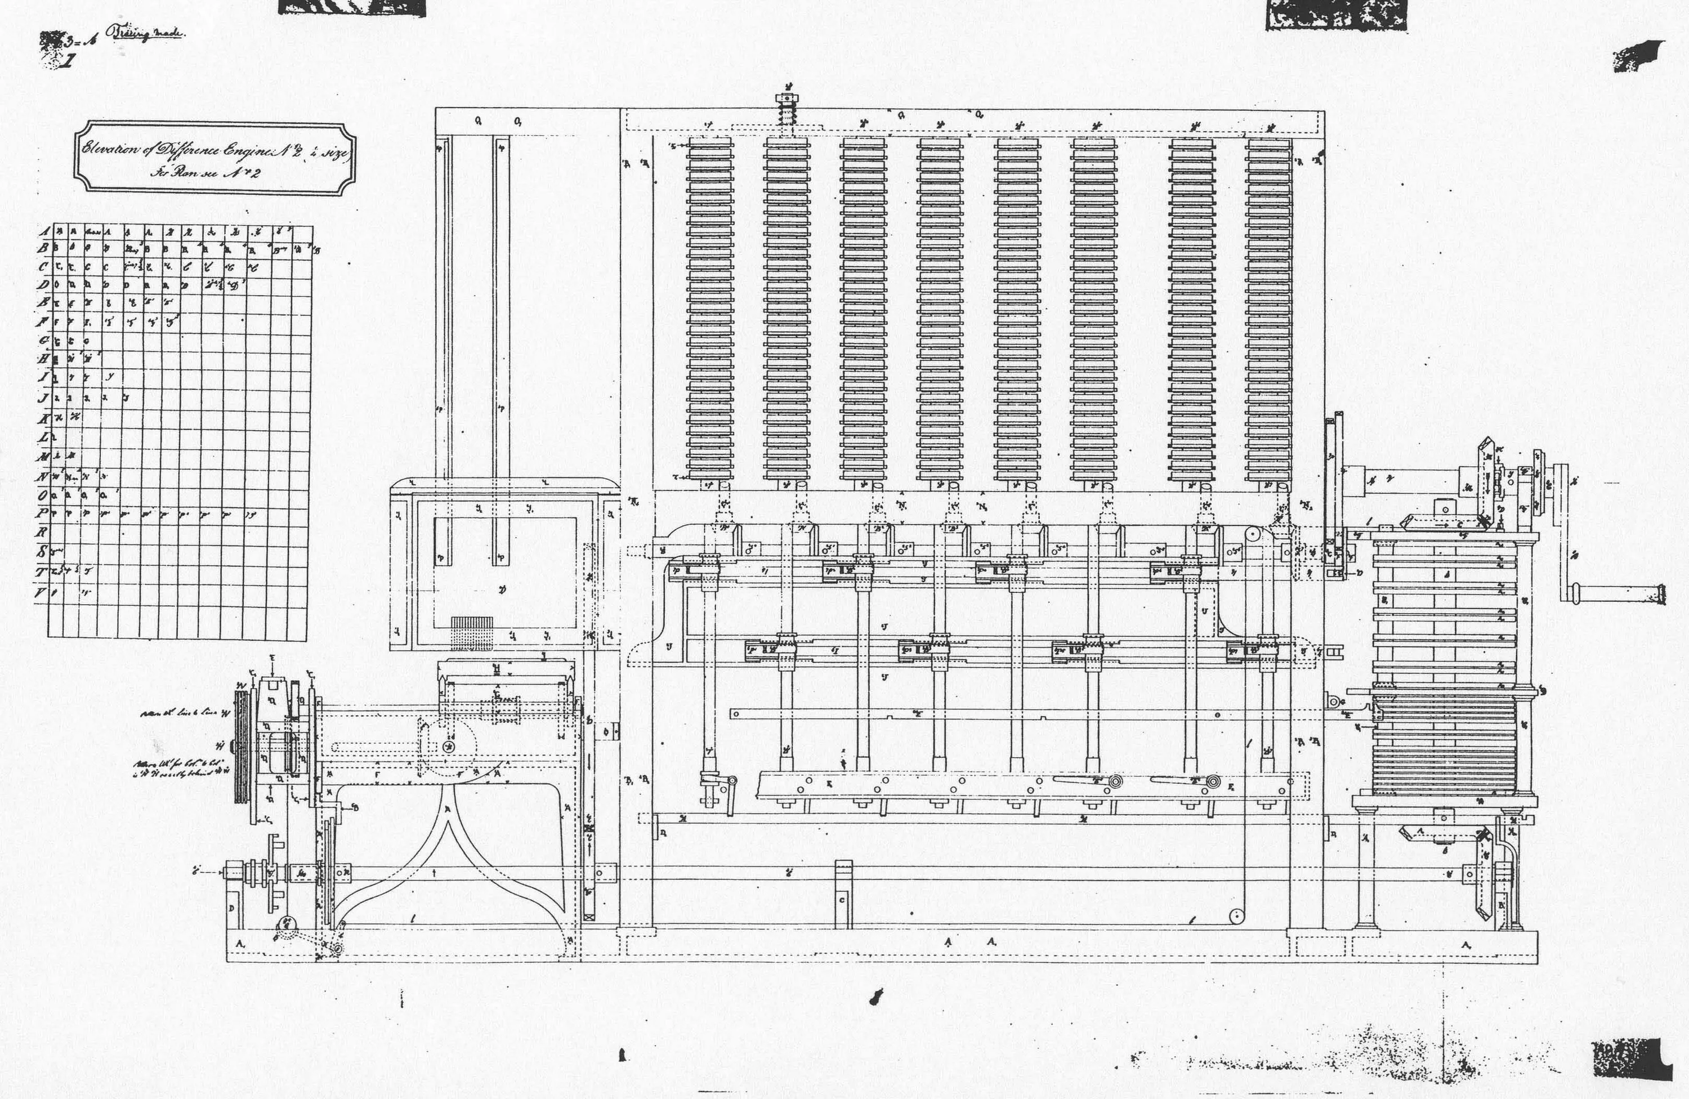
The Meeting of Minds: Ada and Babbage
Ada Lovelace met Charles Babbage, the inventor of the Analytical Engine, in 1833.
Babbage’s Analytical Engine was a proposed mechanical general-purpose computer.
Ada immediately grasped the Engine’s potential beyond mere calculations.
This marked the beginning of a pivotal partnership.

Slide 4

Beyond Translation: Ada’s Insightful “Notes”
In 1843, Ada translated an article by Italian mathematician Luigi Menabrea on the Analytical Engine.
She added extensive notes that were three times longer than the original article.
These “Notes” demonstrated her profound understanding of the machine.

Slide 5
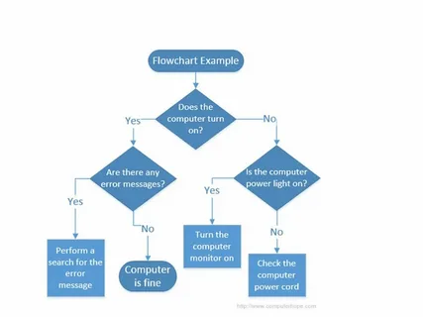
The First Algorithm: A Leap into Programming
Note G contained the first algorithm intended to be processed by a machine – a sequence of operations to calculate Bernoulli numbers.
This algorithm is now recognized as the first computer program.
Ada’s ingenuity laid the foundation for modern programming.

Slide 6
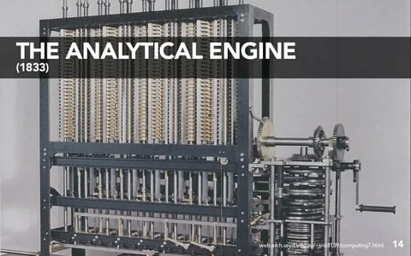
The Power of Abstraction: Envisioning a New Frontier
Ada foresaw the potential of the Analytical Engine to manipulate symbols, not just numbers.
She understood it could compose music, generate graphics, and process various data forms.
Her vision extended beyond calculation to the manipulation of symbols.

Slide 7
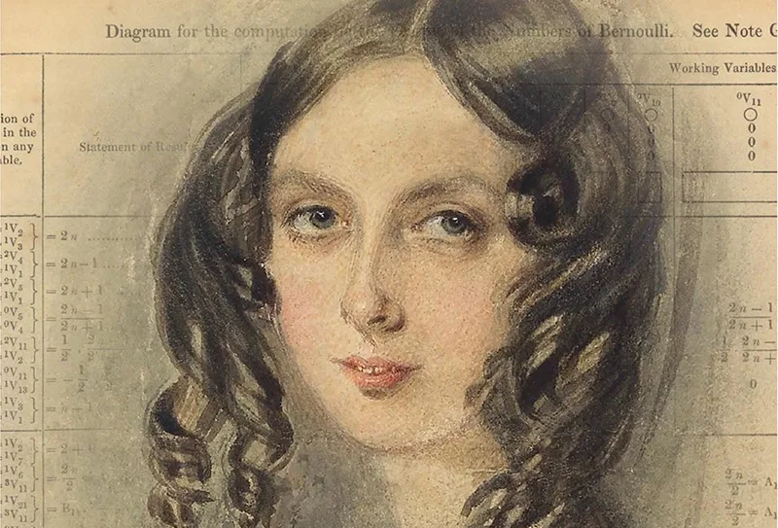
Overcoming Obstacles: Facing Skepticism and Limitations
Ada’s work faced skepticism due to the impracticality of building the Analytical Engine at the time.
She faced social barriers as a woman in a male-dominated field.
Financial constraints and technological limitations hindered the realization of her vision.

Slide 8
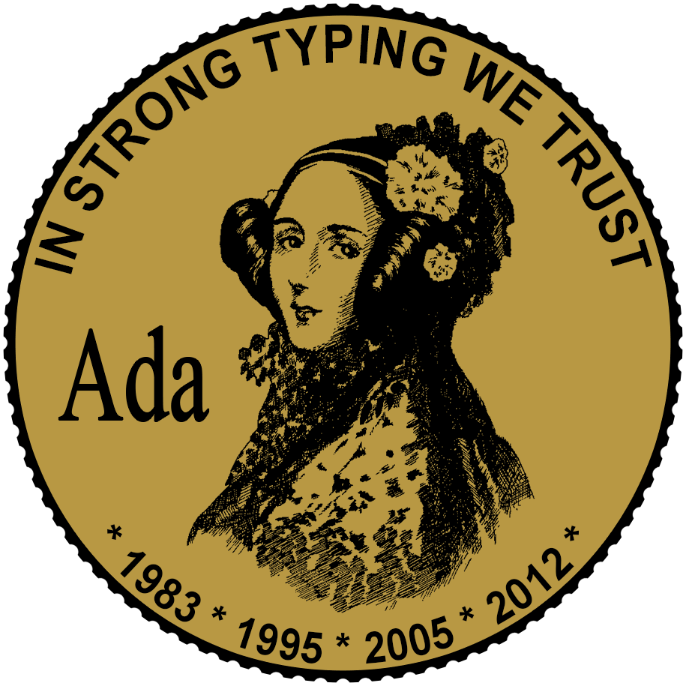
A Lasting Legacy: Honoring a Pioneer
Ada Lovelace’s contributions went largely unrecognized during her lifetime.
Her work was rediscovered and celebrated in the 20th century.
The Ada programming language, developed by the US Department of Defense, is named in her honor.

Slide 9
Sparking Innovation: Ada’s Enduring Influence
Ada Lovelace inspires programmers, scientists, and engineers across the globe.
She highlights the importance of creativity and interdisciplinary thinking in technological advancement.
Her legacy encourages young women to pursue careers in STEM fields.

Slide 10
Ada Lovelace: A Timeless Visionary
Ada Lovelace was a remarkable figure who bridged the gap between mathematics, science, and art.
Her vision of computing as a tool for manipulating symbols has shaped the digital world we live in.
Her story is a testament to the power of innovation and the importance of recognizing the potential in every individual.

